Slide 1


E-Commerce Marketing Performance Analytics
DRevenue Growth, Channel Efficiency & Customer Retention Strategy
Presented By:
Md. Maidul Hassan Shanto

Slide 2

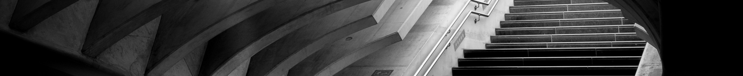
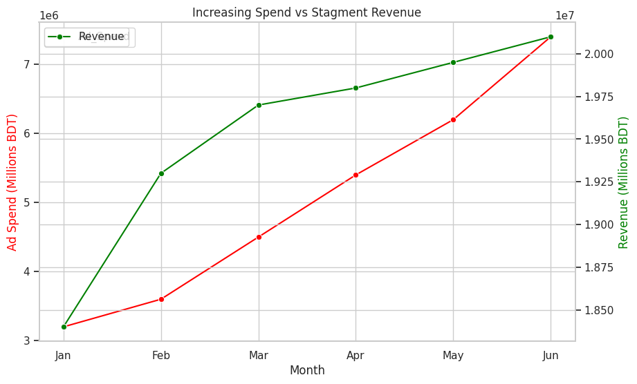
Top 3 Reasons for Slowing Revenue Growth
Decreasing Conversion Rate (CR): While sessions grew by 62% (from 420k in Jan to 680k in Jun), orders only grew by 14% (9.2k to 10.5k). The conversion rate dropped from 2.19% in January to 1.54% in June.
​
Diminishing Returns on Ad Spend: Ad spend increased by 131% (3.2M to 7.4M), but revenue only increased by 9% (18.4M to 20.1M). You are paying significantly more to acquire users who are spending less.
​
Declining Average Order Value (AOV): In January, the AOV was 2,000 BDT. By June, it dropped to 1,914 BDT. We are attracting "window shoppers" or low-value customers rather than high-spenders.
Comment:
​Revenue has grown 9.2% over 6 months, while Ad Spend surged by 131.2%. It's a "Diminishing Returns" phase where every additional BDT spent is generating significantly less incremental revenue.
​The widening gap between marketing investment and revenue indicates that the scaling strategy is currently inefficient.

Slide 3

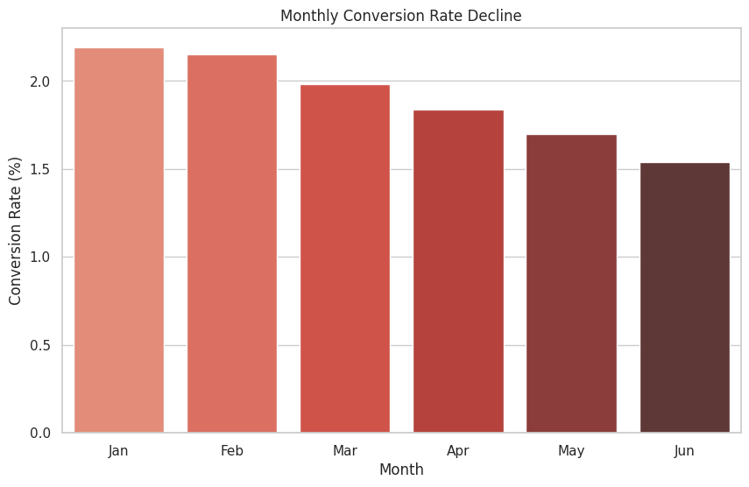
Traffic Quality & Conversion Decay
Increasing Traffic, Decreasing Intent.
Total Sessions rose by 62%, but the Conversion Rate plummeted from 2.19% in Jan to 1.54% in Jun.
​We are driving "top-of-funnel" traffic that isn't converting. This suggests our current ad targeting is attracting low-intent users.
Comment:
Monthly sessions increased from 420,000 to 680,000 (+62%), but Conversion Rate (CR) dropped from 2.19% to 1.54%.
High traffic volume is masking a significant drop in traffic quality. ​We are successfully attracting visitors, but they have lower purchasing intent or find the platform's user experience (UX) friction too high for the current product mix.

Slide 4

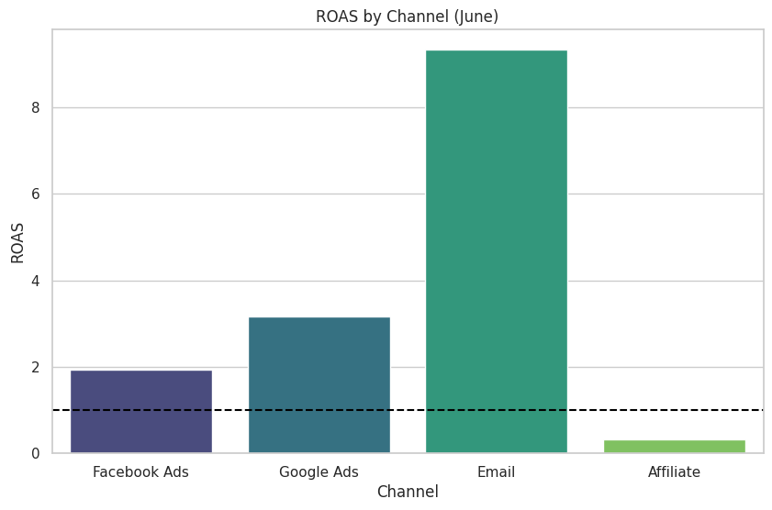
Channel Performance Analysis
For the month of June.
Google Ads is your most efficient paid channel with a conversion rate of 2.05
Emails also hold a good position with a ROAS score of 9.33
Affiliate is the worst performer, costing 2,250 BDT per order while only generating 300,000 BDT in total revenue.
Comment:
Google Ads ROAS is 3.16; Affiliate ROAS is 0.33. CAC for Affiliate is 2,250 BDT compared to 641 BDT for Google.
Affiliate Marketing is currently burning cash, costing more to acquire a customer than the revenue they generate.
​Email Marketing is our most efficient hidden gem with a 9.33 ROAS, suggesting we should shift focus toward our existing database.

Slide 5
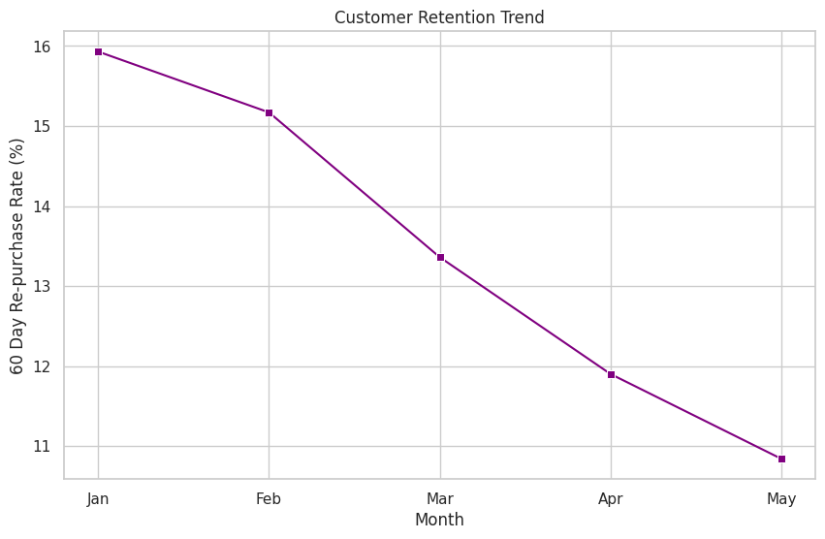
The Retention Crisis
Acquisition Scaling is Hiding a Retention Problem.
While new user acquisition is up 93%, the 60-day re-purchase rate has dropped from 15.9% (Jan) to 10.8% (May).
​We are failing to build customer loyalty. It is 5-7x cheaper to retain a customer than to acquire a new one and our current strategy ignores this.
Comment:
​We are operating a "Leaky Bucket" model where we are paying high premiums to acquire new users but failing to keep them.
​Sustainable growth requires a pivot toward retention, even a 5% drop in retention drastically reduces the long-term Lifetime Value (LTV) of our customers.

Slide 6
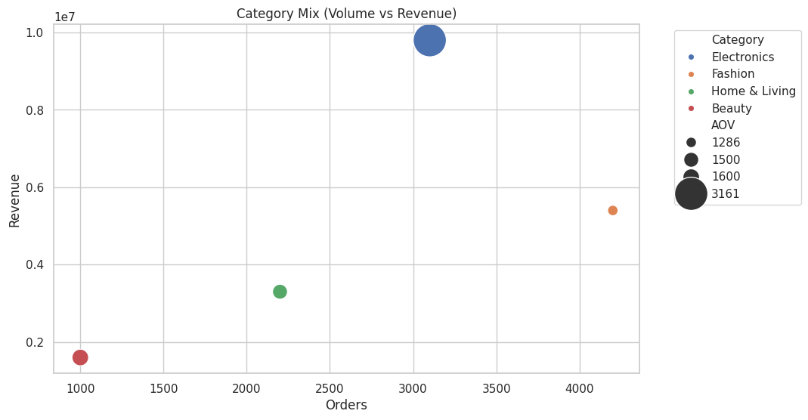
Category Performance Analysis
Path to Sustainable Growth.
Strongest by Volume (Orders): Fashion
​With 4,200 orders, this category drives the highest frequency of transactions, making it the primary driver for customer acquisition and site traffic.
​
Strongest by Revenue: Electronics
​Generating 9,800,000 BDT, Electronics accounts for nearly 49% of the total monthly revenue (out of 20.1M BDT total). It is the heavy lifter for the company’s top-line growth.
​Strongest by Average Order Value (AOV): Electronics
​At 3,161 BDT per order, it significantly outperforms the other categories (the next closest is Beauty at 1,600 BDT).
Comment:
Lean into Electronics for Revenue/AOV and use Fashion for high-volume customer acquisition.
​Pivot to Retention: Launch a CRM/Email loyalty campaign (Email currently has an impressive 9.33x ROAS).
​Audit Ad Creative: Investigate why Facebook Ads conversion is lagging behind Google.
​AOV Optimization: Introduce cross-category bundles (e.g., Beauty + Fashion) to raise average ticket size.

Slide 7
Thank you!

